Slide 1
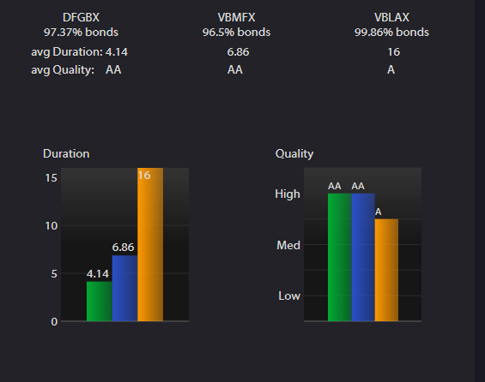
Review of Bond Funds

Slide 2
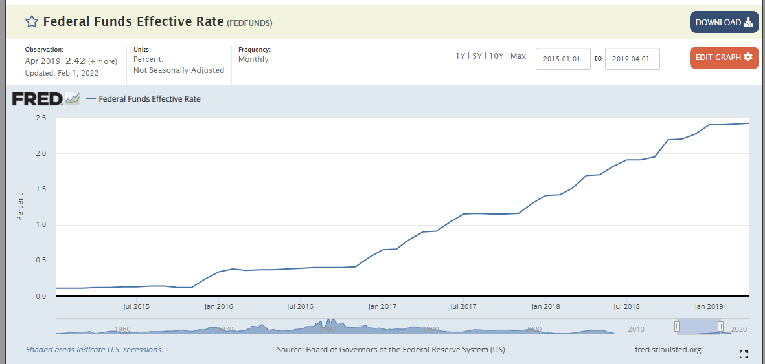
Rising Rate Environment 01/2015-04/01/2019

Slide 3
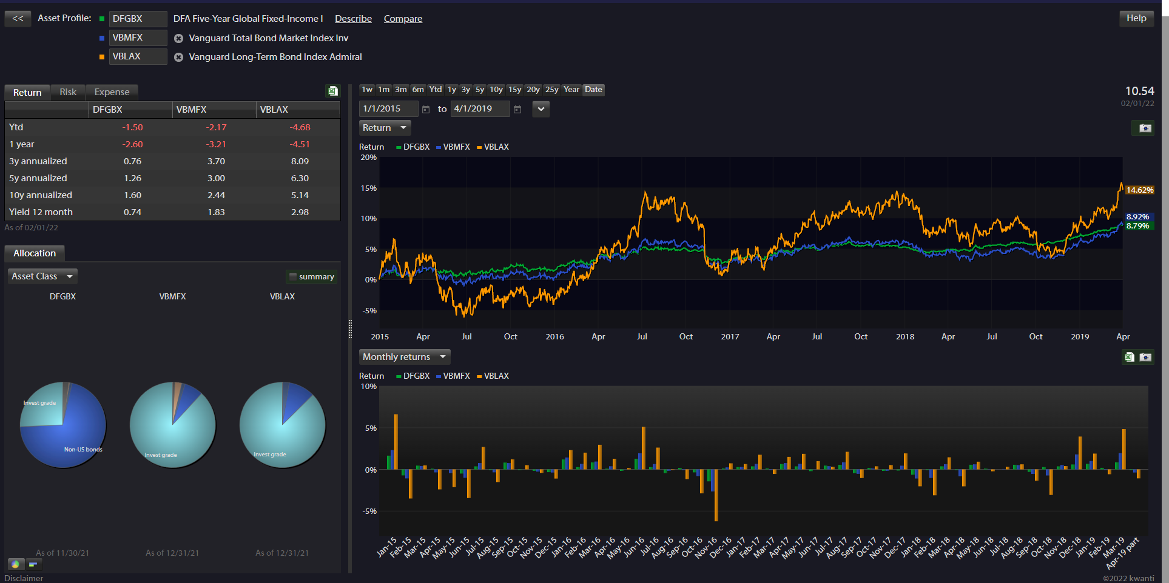
Returns 01/2015-04/01/2019

Slide 4
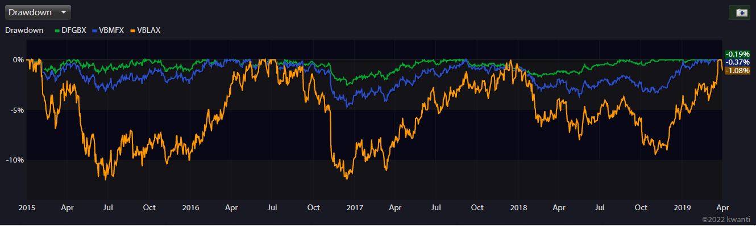
Drawdowns During That Period

Slide 5
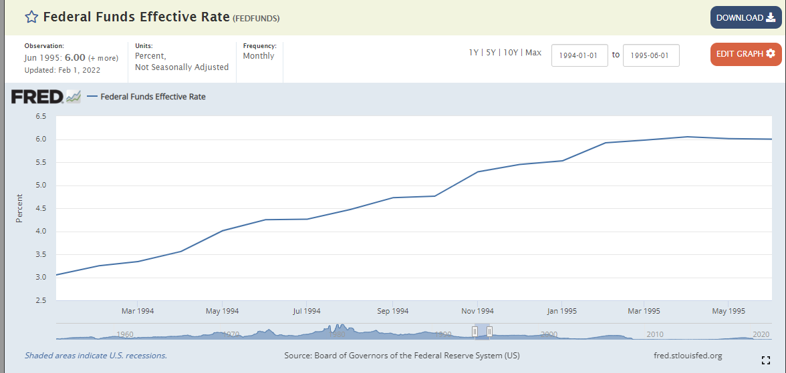
1994 To 1995 Rate Rise

Slide 6
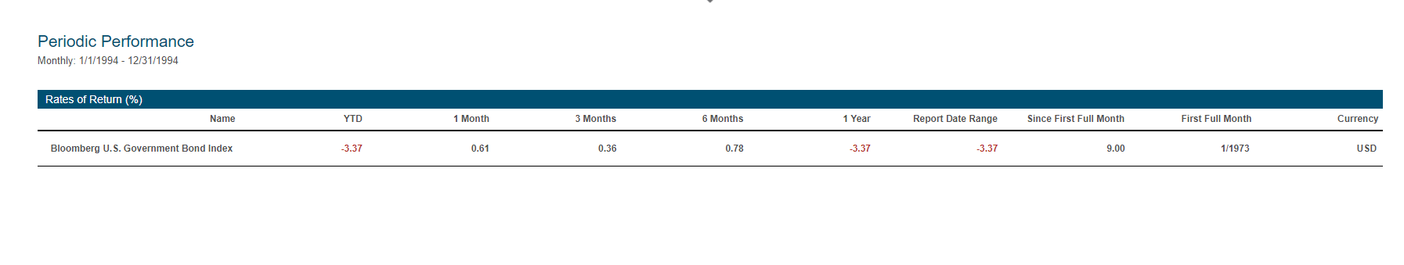
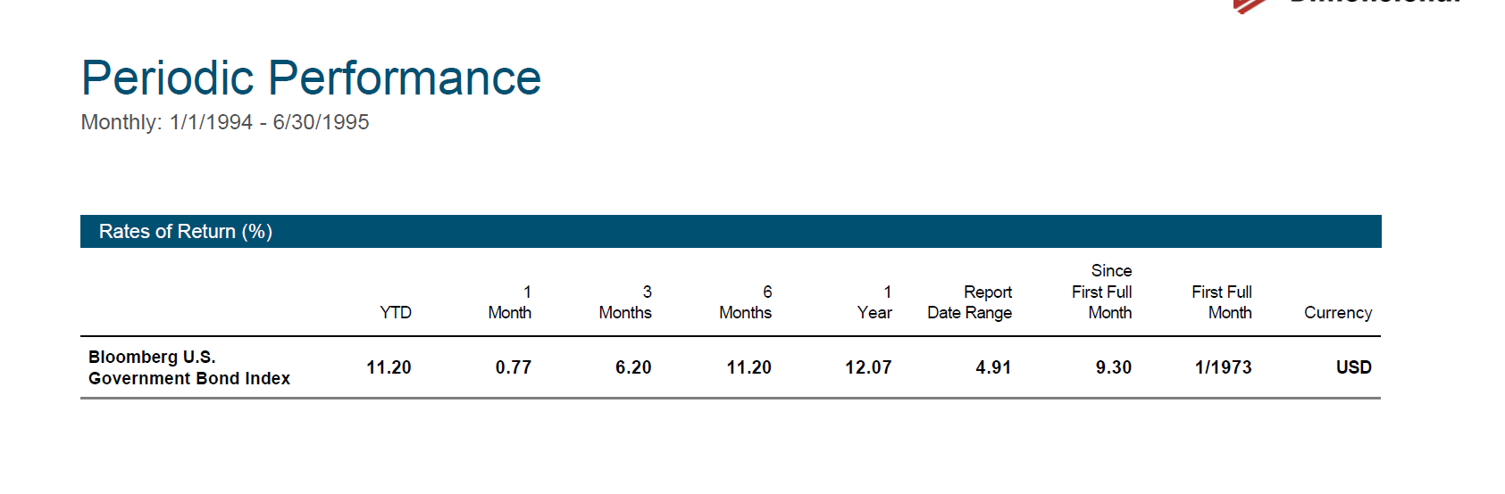

Slide 7
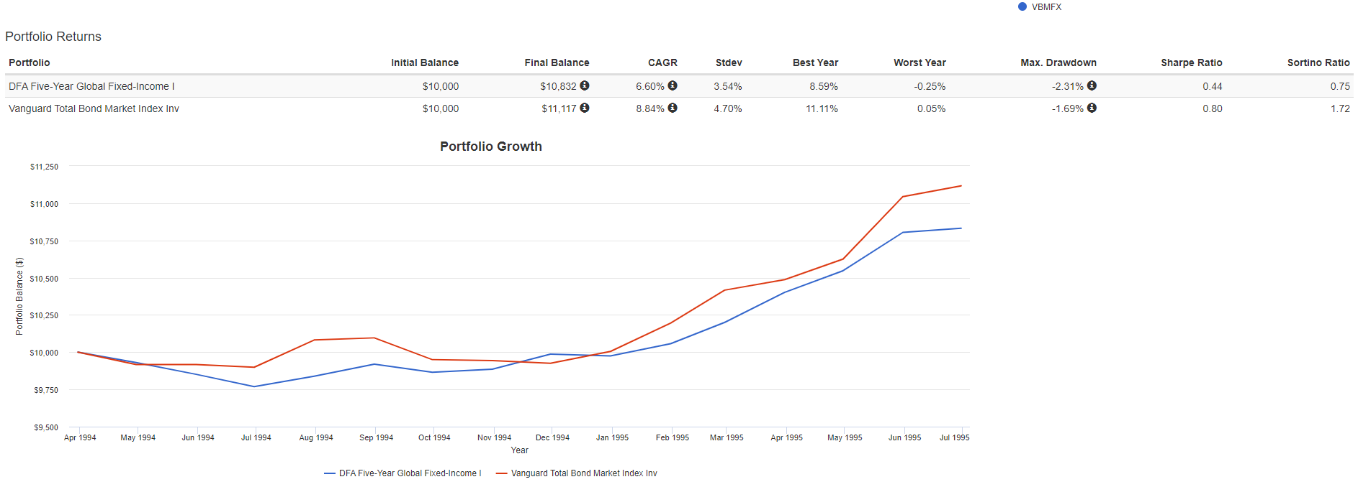
Performance Over That Period

Slide 8
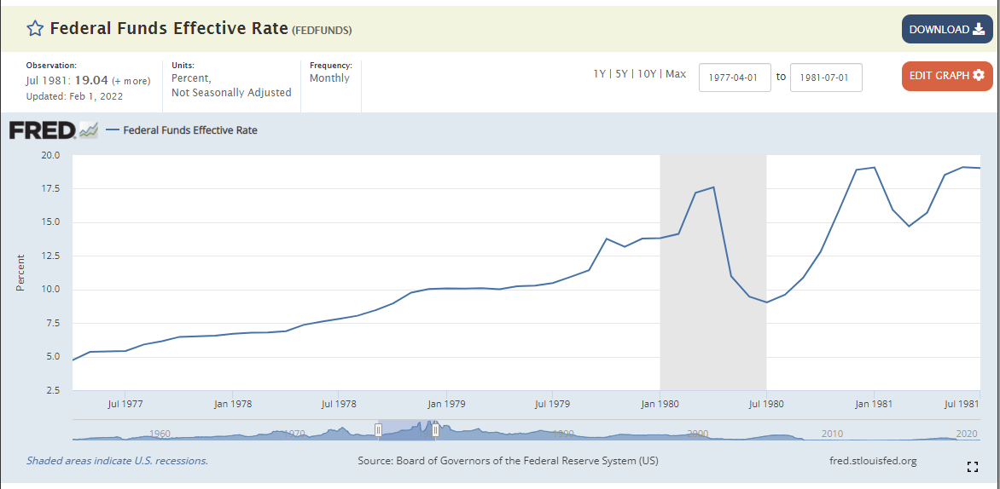
Rising Rate Environment 04/01/1977-07/01/1981

Slide 9
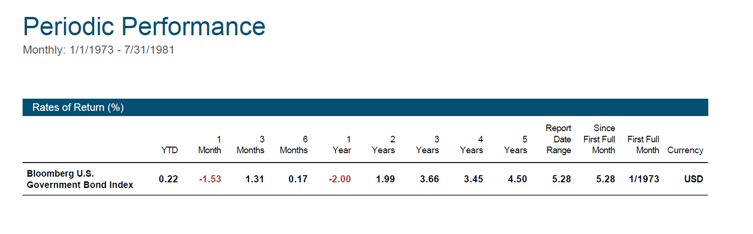

Slide 10
Inflation Is The Bigger Culprit on Real Returns For Bonds
Year | Inflation Rate | S&P 500 (includes dividends)2 | 3-month T. Bill (Real) | 10-year T.Bonds | Baa Corp Bonds | Real Estate3
1980 | 12.52% | 17.08% | -0.96% | -13.78% | -14.07% | -4.55%
2009 | 2.72% | 22.60% | -2.50% | -13.47% | 20.06% | -6.40%
1946 | 18.13% | -22.48% | -15.03% | -12.70% | -13.23% | 5.05%
1979 | 13.29% | 4.61% | -2.85% | -11.14% | -13.51% | 0.40%
1941 | 9.93% | -20.65% | -8.91% | -10.87% | -4.48% | -16.66%
2021 | 7.00% | 20.06% | -6.49% | -10.67% | -5.67% | 9.19%
1999 | 2.68% | 17.72% | 1.90% | -10.65% | -1.79% | 4.86%
1969 | 6.20% | -13.60% | 0.44% | -10.56% | -7.74% | 0.75%
2013 | 1.50% | 30.19% | -1.42% | -10.45% | -2.52% | 9.08%
1994 | 2.67% | -1.31% | 1.53% | -10.43% | -3.89% | -0.16%
1974 | 12.34% | -34.04% | -4.01% | -9.21% | -14.88% | -2.02%
1987 | 4.43% | 1.32% | 1.28% | -9.00% | -2.05% | 3.30%
1978 | 9.02% | -2.30% | -1.68% | -8.99% | -5.39% | 6.15%
1947 | 8.84% | -3.34% | -7.57% | -7.27% | -7.88% | 11.42%
1942 | 9.03% | 9.30% | -7.97% | -6.18% | -3.53% | -5.23%
1951 | 6.00% | 16.68% | -4.23% | -5.94% | -5.84% | 0.04%
1950 | 5.93% | 23.48% | -4.46% | -5.19% | -1.60% | -2.16%
1956 | 2.99% | 4.33% | -0.35% | -5.09% | -5.18% | -2.01%
1977 | 6.70% | -12.82% | -1.34% | -5.07% | 3.05% | 7.45%
1973 | 8.71% | -21.17% | -1.54% | -4.64% | -4.04% | -4.86%
1967 | 3.04% | 20.15% | 1.23% | -4.48% | -2.08% | -0.70%
1959 | 1.73% | 10.15% | 1.63% | -4.30% | -0.15% | -1.59%
1958 | 1.76% | 41.23% | 0.01% | -3.79% | 4.59% | -1.08%
1975 | 6.94% | 28.11% | -1.09% | -3.12% | 3.85% | -0.15%

