Slide 1
Onboarding Alignment
Notes:
How to set up power point in zoom with presenter notes: https://support.microsoft.com/en-us/office/start-the-presentation-and-see-your-notes-in-presenter-view-4de90e28-487e-435c-9401-eb49a3801257

Slide 2
Agenda Core Deliverables Advice Pay: Engagement Letter Advice Pay: Billing RightCapital: Building the Plan

Slide 3
Core Three Deliverables
New Clients Core
Comprehensive Financial Plan
Tax Report/Tax Plan
Investment Plan
Comprised of:
Risk Questionnaire
IPS
Investment Personality Assessment
Ongoing Core
Financial Plan Summary
Tax Report/Summary
Portfolio Investment Summary
Phase 1
Phase 2
Organize
Analyze
Decide
Act
1
2
3
4

Slide 4
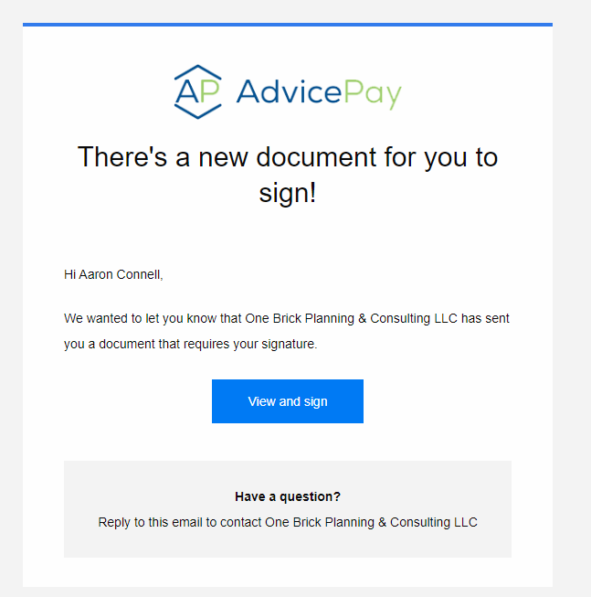
Sign Engagement Letter
You will receive an email that will prompt you to sign the engagement letter. Please review and ask us any questions if you have them!
Once the primary client signs, it will also go to the spouse (if applicable) for their signature.

Slide 5
Billing
How It’s Done
If you have < $300,000 you will setup up fee billing through our payment system AdvicePay (see slides 4-7) and the amount is billed via ACH from your bank account. All billing is done in arrears.
Two Options
Quarterly ($3,000/4= $750 a quarter)
Monthly ($3,000/12= $250 a month)
2) Once you have exceeded >$300,000 in assets we bill the assets on the quarterly basis at the end of the quarter. (see fee schedule at end of slide deck)

Slide 6
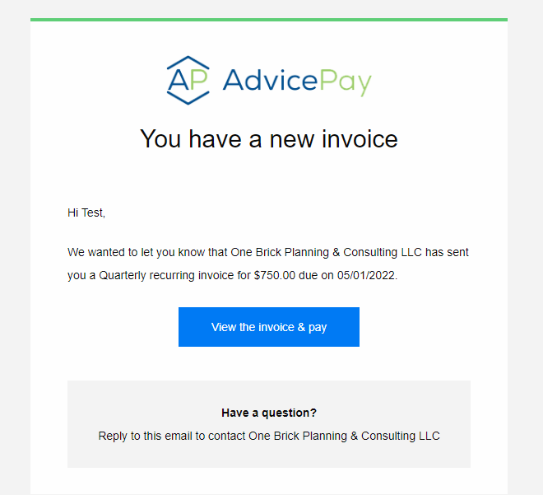
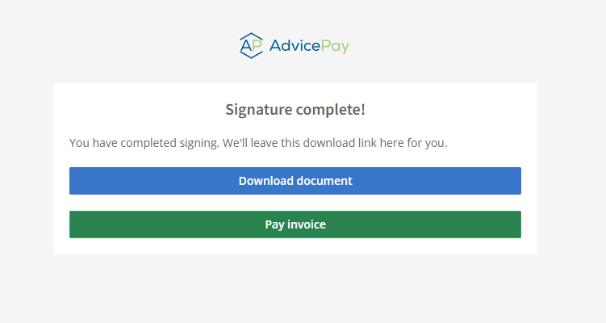
Billing

Slide 7
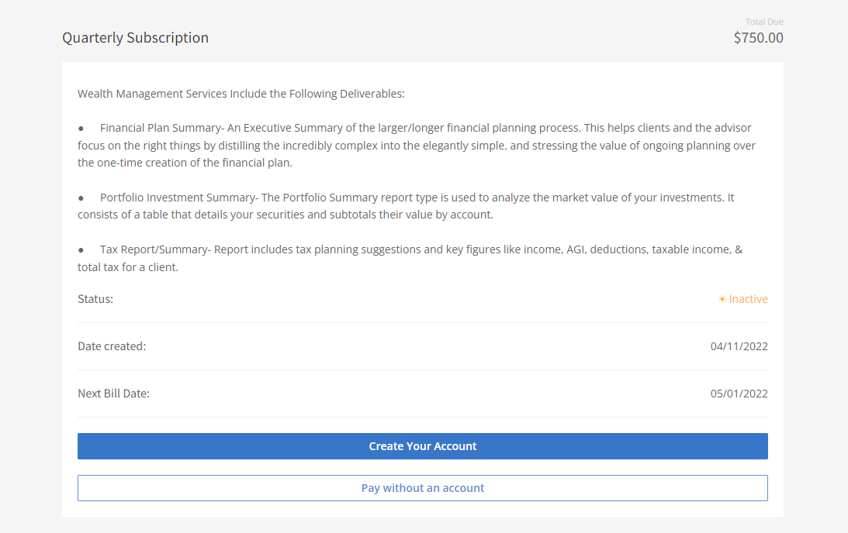
Billing

Slide 8
Billing
Connect Your Bank Account To Plaid
Notes:
Do you want to set up billing now?

Slide 9
Building The Initial Plan
What do we need from you?
Aggregate Data In Client Portal
Complete Document Checklist
Organize
Analyze
Decide
Act
1
2
3
4
INITIAL DOCUMENT CHECKLIST

Slide 10
Getting Started Guides
Our Firm leverages RightCapital, a financial planning software platform, that helps us build plans for our clients. It acts as one centralized hub for sharing documents and gathering data.
Getting Started
Getting Started - Using Your Portal - a brief guide to showcase the value of your portal.
Filling Out Your Profile - a brief guide to help you begin filling out your financial plan.
Account Aggregation
Linking Your Accounts - a one-page tutorial for clients to link their outside accounts.
Troubleshooting Common Aggregation Errors - a one-page tutorial to assist clients who experience error messages while linking their outside accounts. This PDF helps clients resolve the issue on their own and take the appropriate next steps if needed.
Data Security
Client account security - a one-page PDF highlighting the security and safeguards for data
Other Resources
Client Facing PDF's and Videos
Notes:
Would you like assistance setting up and linking your accounts? If not, follow up in 1 week with client.
Reference the google checklist. Ask if they want assistance downloading the RightCapital App.

Slide 11
Video Walk Through
Notes:
Would you like assistance setting up and linking your accounts? If not, follow up in 1 week with client.
Reference the google checklist. Ask if they want assistance downloading the RightCapital App.

Slide 12
App Download
https://help.rightcapital.com/article/205-rightcapital-mobile-app
Notes:
Would you like assistance setting up and linking your accounts? If not, follow up in 1 week with client.
Reference the google checklist. Ask if they want assistance downloading the RightCapital App.

Slide 13
Follow Ups/Tasks
Action Item Sent Via Email & Text
Client Reviews/Takes Action On Item
Client Marks Complete
One Brick Team Notified
Notes:
Would you like assistance setting up and linking your accounts? If not, follow up in 1 week with client.
Reference the google checklist. Ask if they want assistance downloading the RightCapital App.

Slide 14
Thank You

